Slide 1

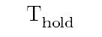

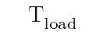
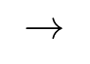
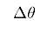
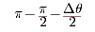
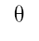
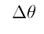
$$π−\frac{π}{2}−\frac{∆θ}{2}$$
$$\frac{∆θ}{2}$$
$$θ$$
$$Δθ$$
$$→$$
$$T_{load}$$
$$T_{hold}$$
$$∆θ$$
$$T_{load}$$
$$T_{hold}$$

Slide 2

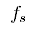
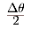
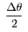
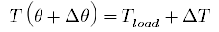
$$N$$
$$f_{s}$$
$$\frac{Δθ}{2}$$
$$\frac{Δθ}{2}$$
$${T(θ)=T}_{load}$$
$$T\left(θ+Δθ\right)=T_{load}+∆T$$
$$Δθ$$

Slide 4
Relatively lower percentage error
Relatively higher percentage error
beyond maximum tensile strength, string breaks

Slide 5
1
a
b
b
Sobel Operator
2
1
2
a
3
GIMP
b
a
4
3
4
a
b

Slide 6
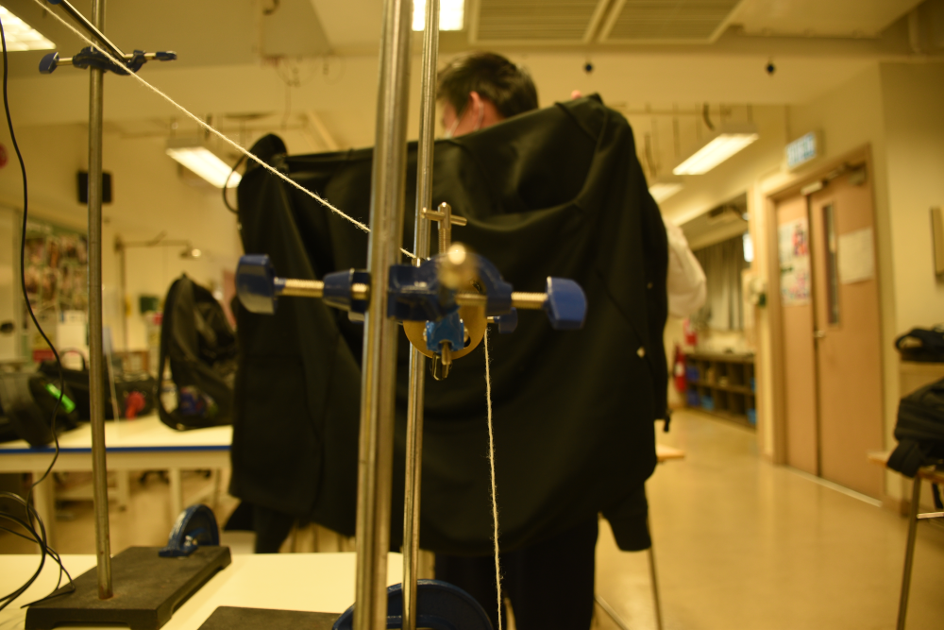
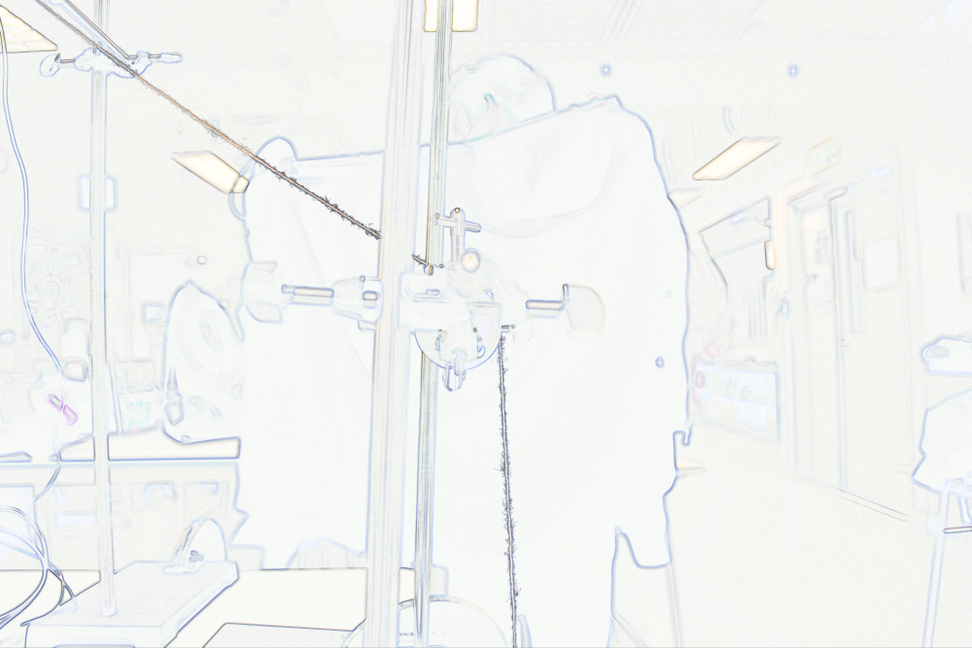
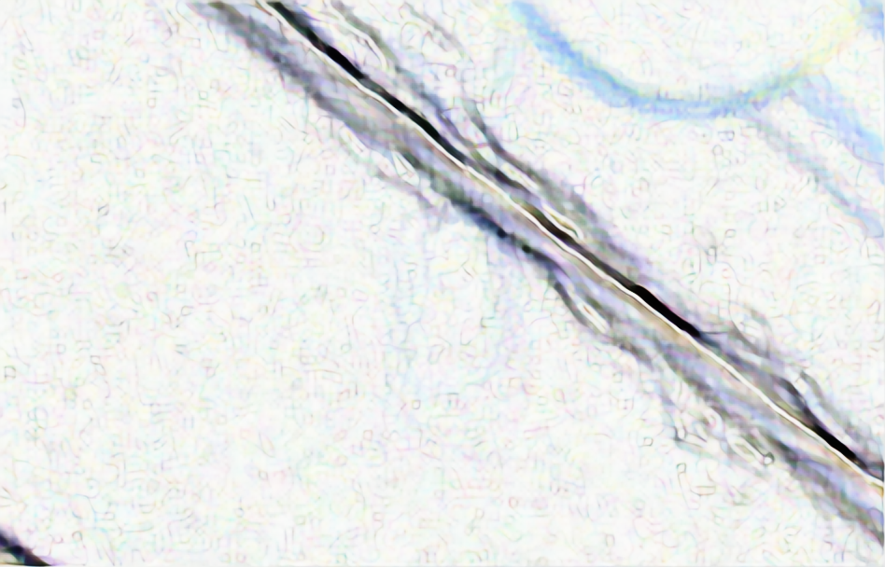
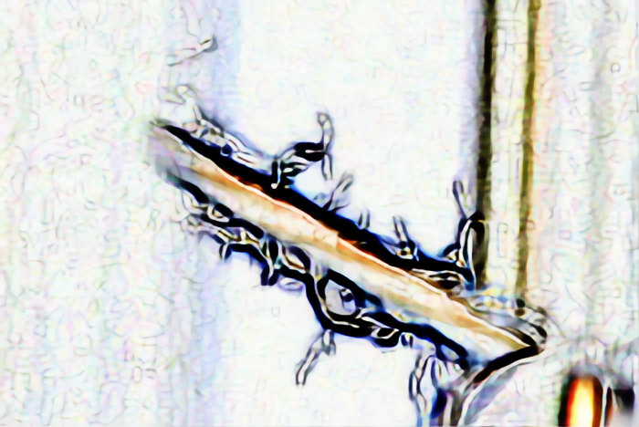
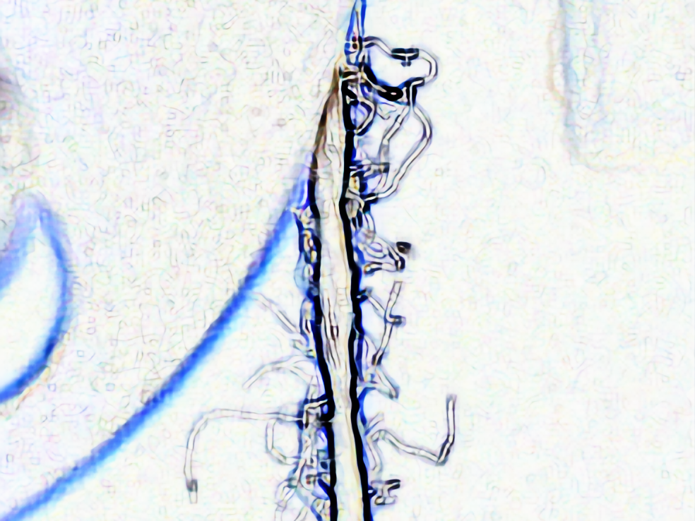
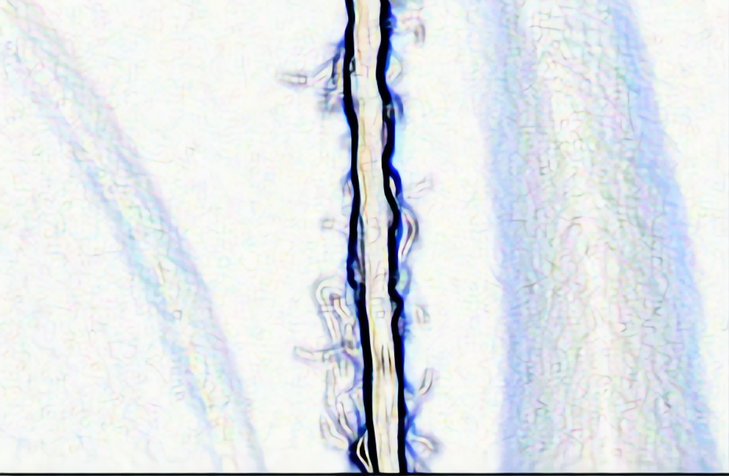
1
a
b
b
Sobel Operator
2
1
2
a
3
GIMP
b
a
4
3
4
a
b

Slide 7
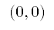
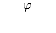
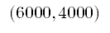
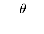
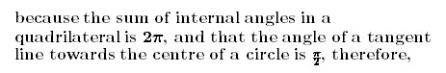
a photograph of a side view of the setup
$$(0, 0)$$
by definition,
$$φ$$
Since internal angles sum up to $2π$ about a point,
$$θ$$
because the sum of internal angles in a quadrilateral is $2π$, and that the angle of a tangent line towards the centre of a circle is $\frac{π}{2}$, therefore,
$$(6000, 4000)$$

Slide 8
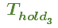

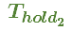
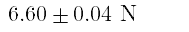
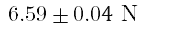
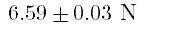
1
$$6.59±0.03 N$$
2
$$6.59±0.04 N$$
$$T_{{hold}_{1}}$$
$$T_{{hold}_{2}}$$
$$T_{{hold}_{3}}$$
3
$$6.60±0.04 N$$

Slide 9


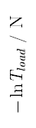
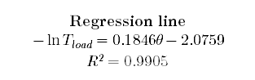

$θ$ / rad
Regression line
$$−\ln{T_{load}}=0.1846θ−2.0759$$
R ² = 0.9905
$−\ln{T_{load}}$ / N
Maximum Gradient line
$$−\ln{T_{load}}=0.2045θ−2.1430$$
Minimum Gradient line
$$−\ln{T_{load}}=0.1733θ−2.0395$$

Slide 10
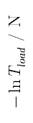
$θ$ / rad
Subramaniam and Natarajan
Belser and Taylor
Kalyanaraman (unwaxed)
$−\ln{T_{load}}$ / N
Shahzad et al. (unwaxed)
Kalyanaraman (waxed)
Kilic and Sülar
Das et al.
Shahzad et al. (waxed)

